Slide 1
Super Luigi Brothers
Megan Adamik, April Yang, Matthew Rozinskas, Marianna Sanchez, Anthony Hernandez

Slide 2
Player and Enemy Classes
The player and enemy classes were created with bounds on the height of the window but not on the width to enable traveling through the walls from one side to the other.
The enemy class has a move function that automatically allows the enemy to move across the screen when the player is moved.

Slide 3
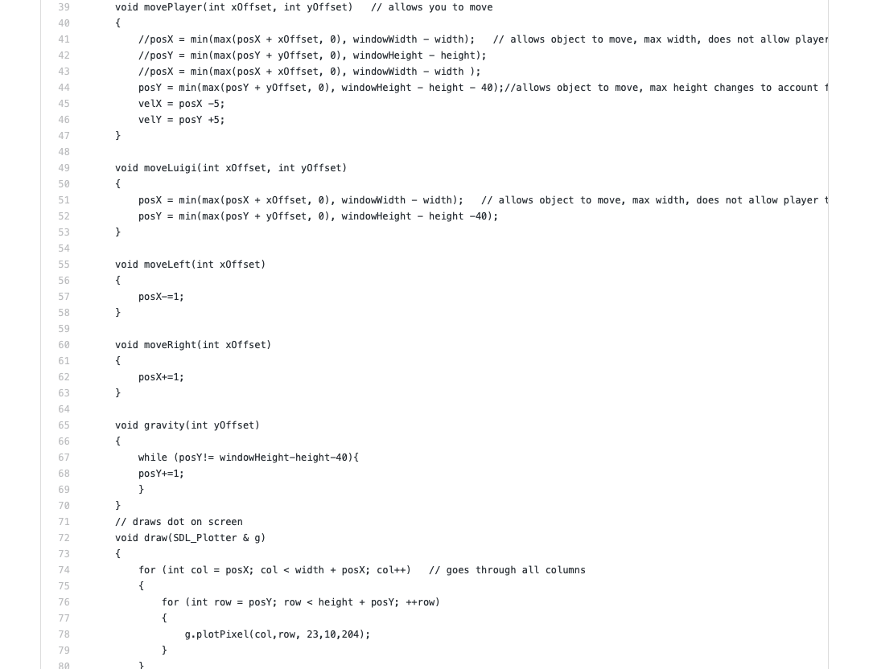
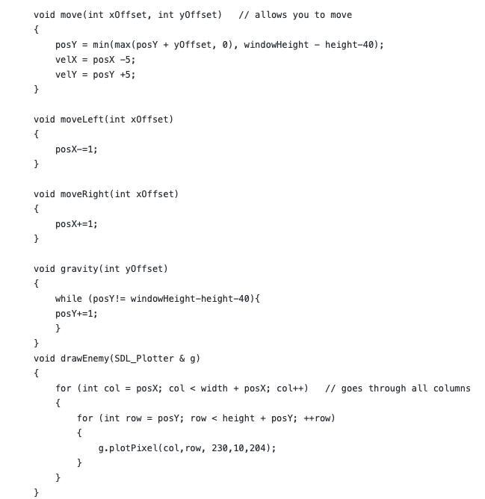
Player
Enemy

Slide 4
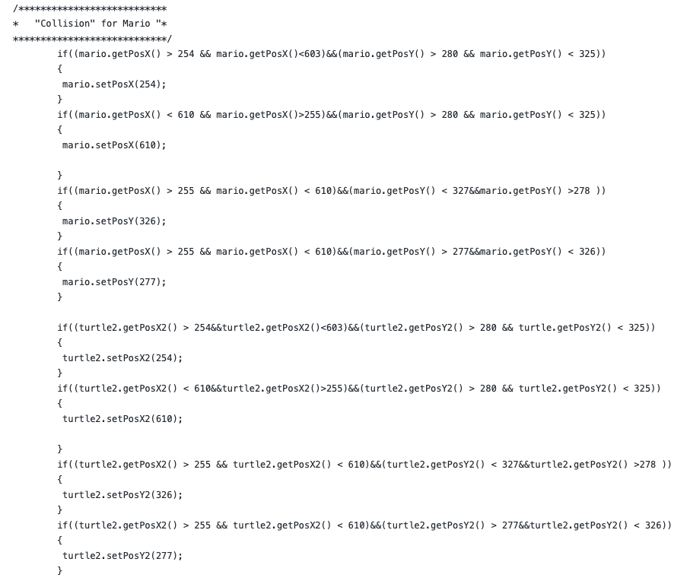
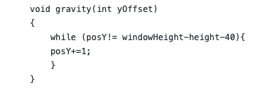
Collision and gravity
Gravity knocks you down when trying to move upward.
If collision is detected on a platform or the floor then the program does not allow the player to go through it.

Slide 5
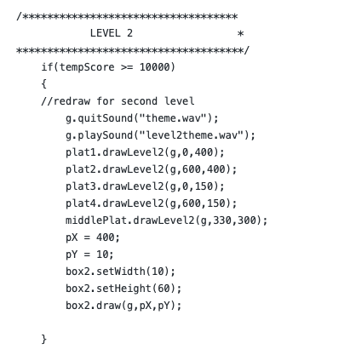
Levels and Score
The levels change depending on the score achieved by the player
Points are achieved by being alive
The player is provided 5 live at the beginning of the game
The score increases when the player kills an enemy or collects a coin
The token class was created with an automatic movement function and no bounds on the width of the screen to continuously travel.

Slide 6
Bonus
Playing the game with 2 players is available and it is a cooperative game
Theme music plays when the players begin to play and continues to play until the player loses all of their lives or they quit the game.
Achieve a score greater than 50,000 to advance to the “secret” Christmas level for a surprise

Slide 7
Goals that were not achieved
Sprites and actual graphics
No point class, no implementation of graphics from files
No collision between classes
Platform collision was achieved but ineffective (jankty)
Jumping parabolas
Gravity works but a parabola was not attained

